Slide 1
The four C’s”
2023-1-IT02-KA121-SCH-000121006
2023-1-IT02-KA121-SCH-000121006
2023-1-IT02-KA121-SCH-000121006
(CreativitY, CRITICAL THINKING, ComMunicaTion AND CollaboraTion)
EU project :2023-1-IT02-KA121-SCH-000121006
Karine M.l.j. Van beek
sending organisation :ipsseoa- soverato Italy

Slide 2
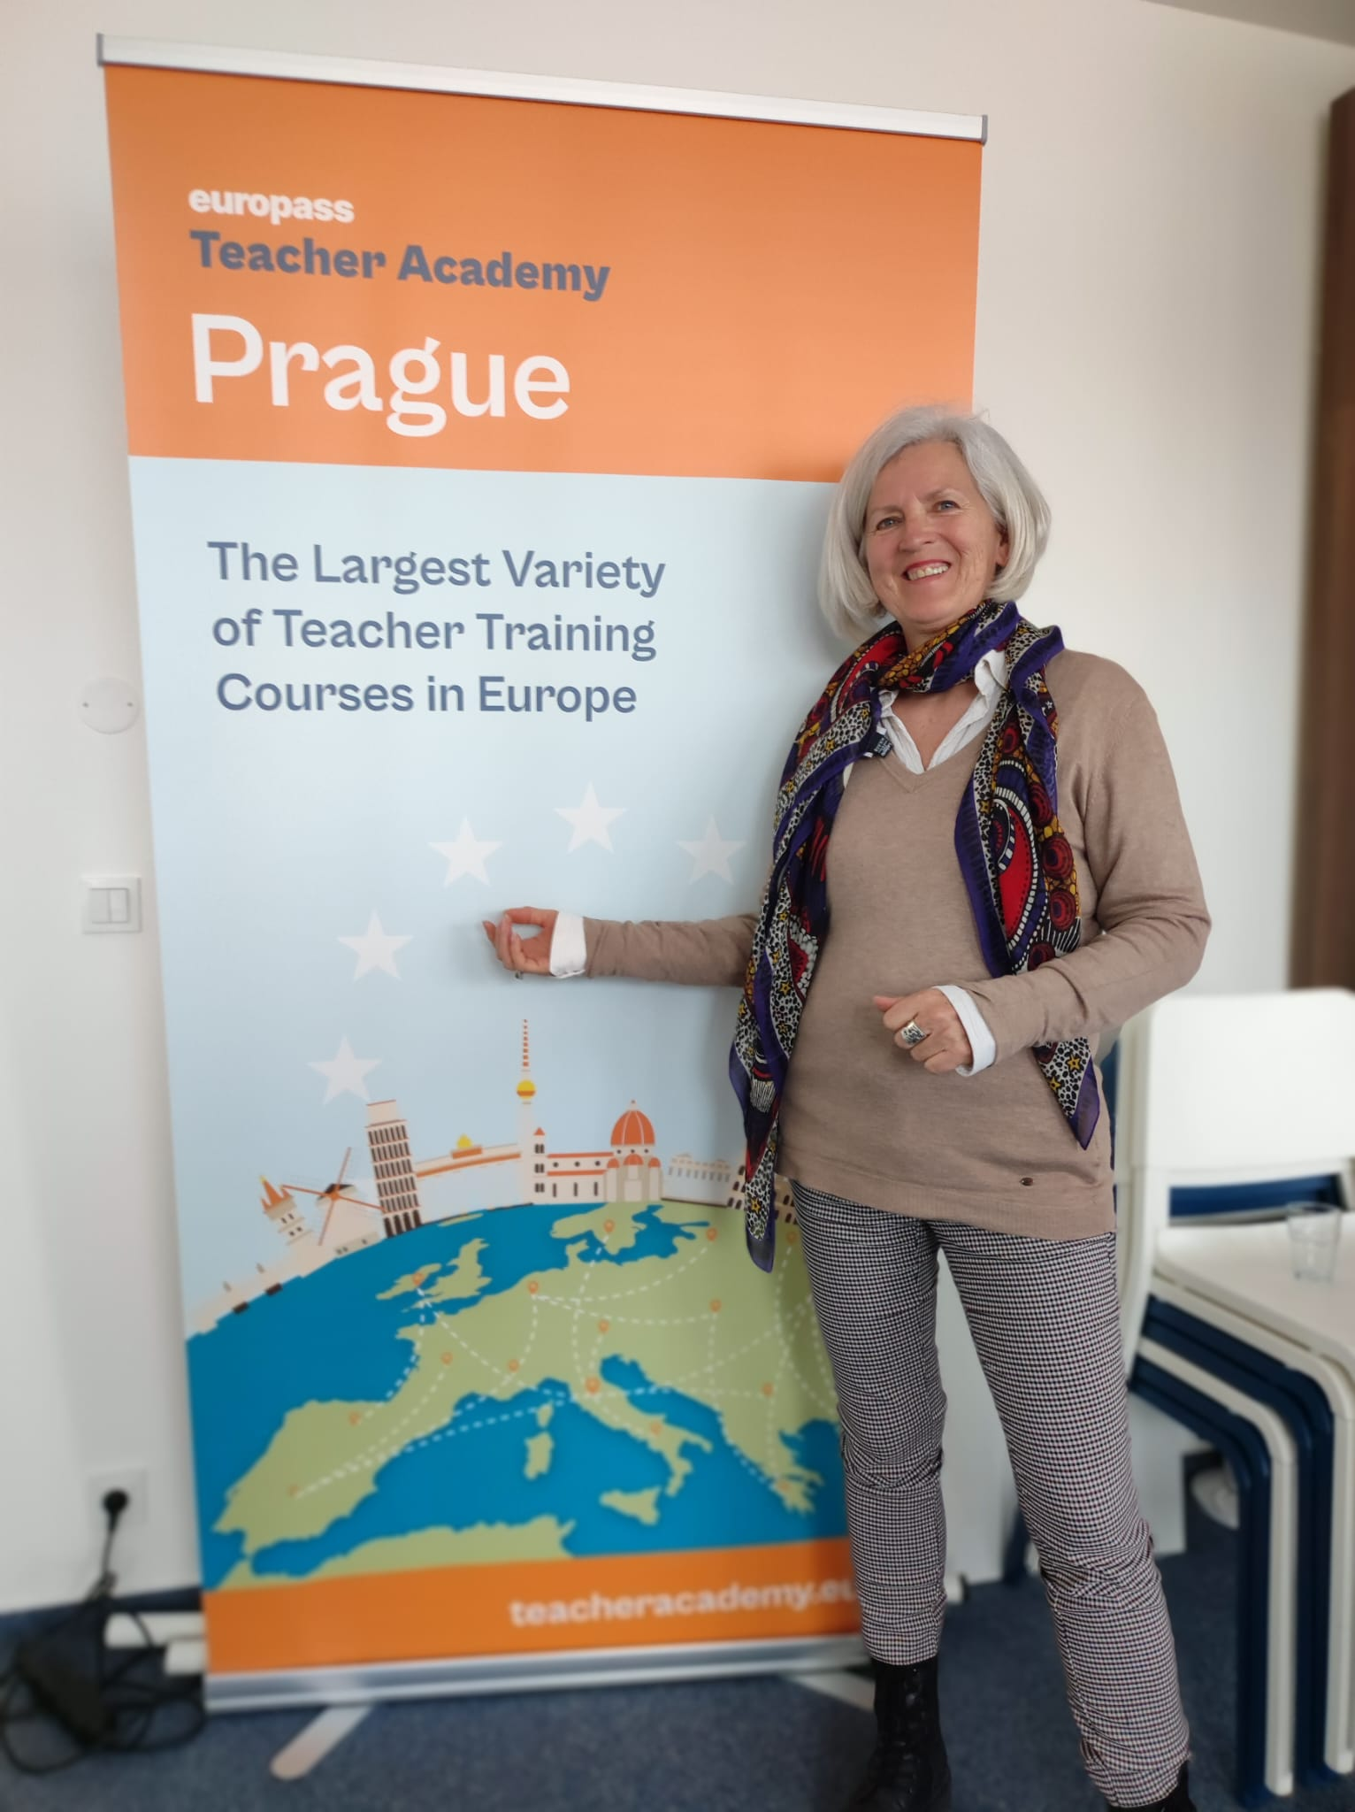

A teacher training course
Aprile 2024 PRAGUE

Slide 3
What are we talking about….
The key competencies for 21st-century learners, the ”Four Cs” (Creativity, Critical Thinking, Communication, and Collaboration) are often embraced in theory yet stump educators in practice.
Creativity and Critical Thinking represent inseparable attitudes and abilities for innovation which, contrary to popular belief, can be learned, taught, and implemented in any classroom
Communication and Collaboration are fundamental life skills that students can draw from in their everyday experiences at school and shape their ability to live, connect with others, and work well in the future.

Slide 4
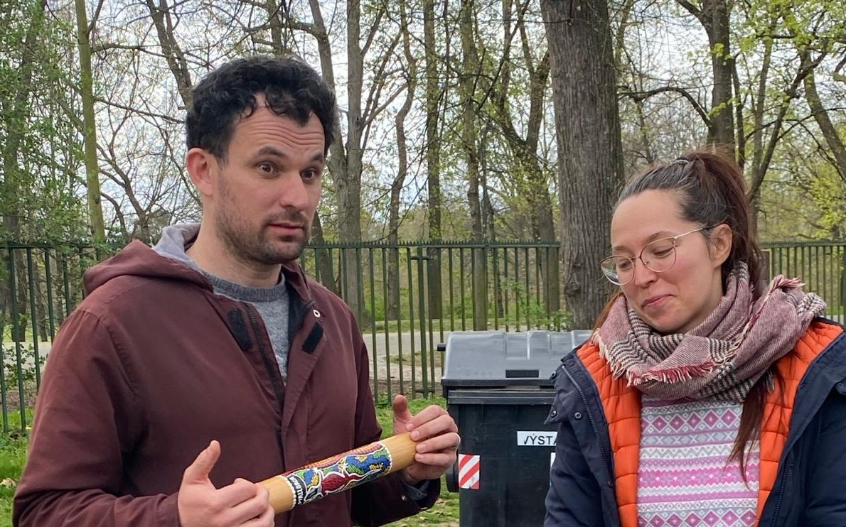
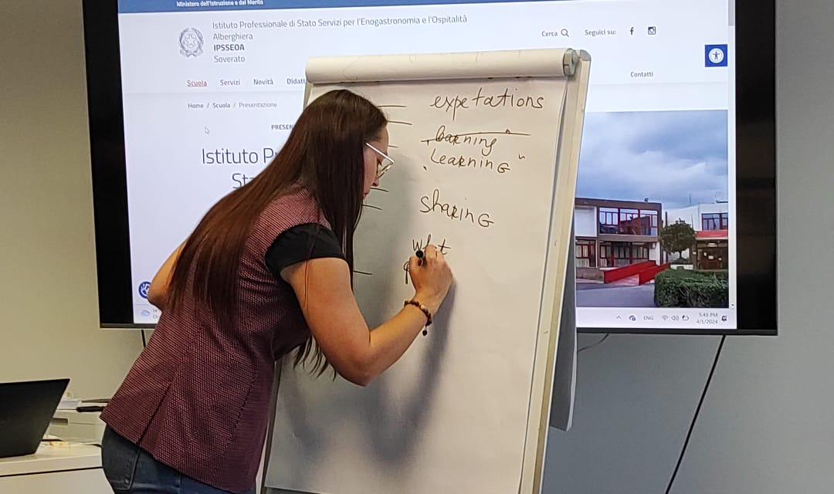
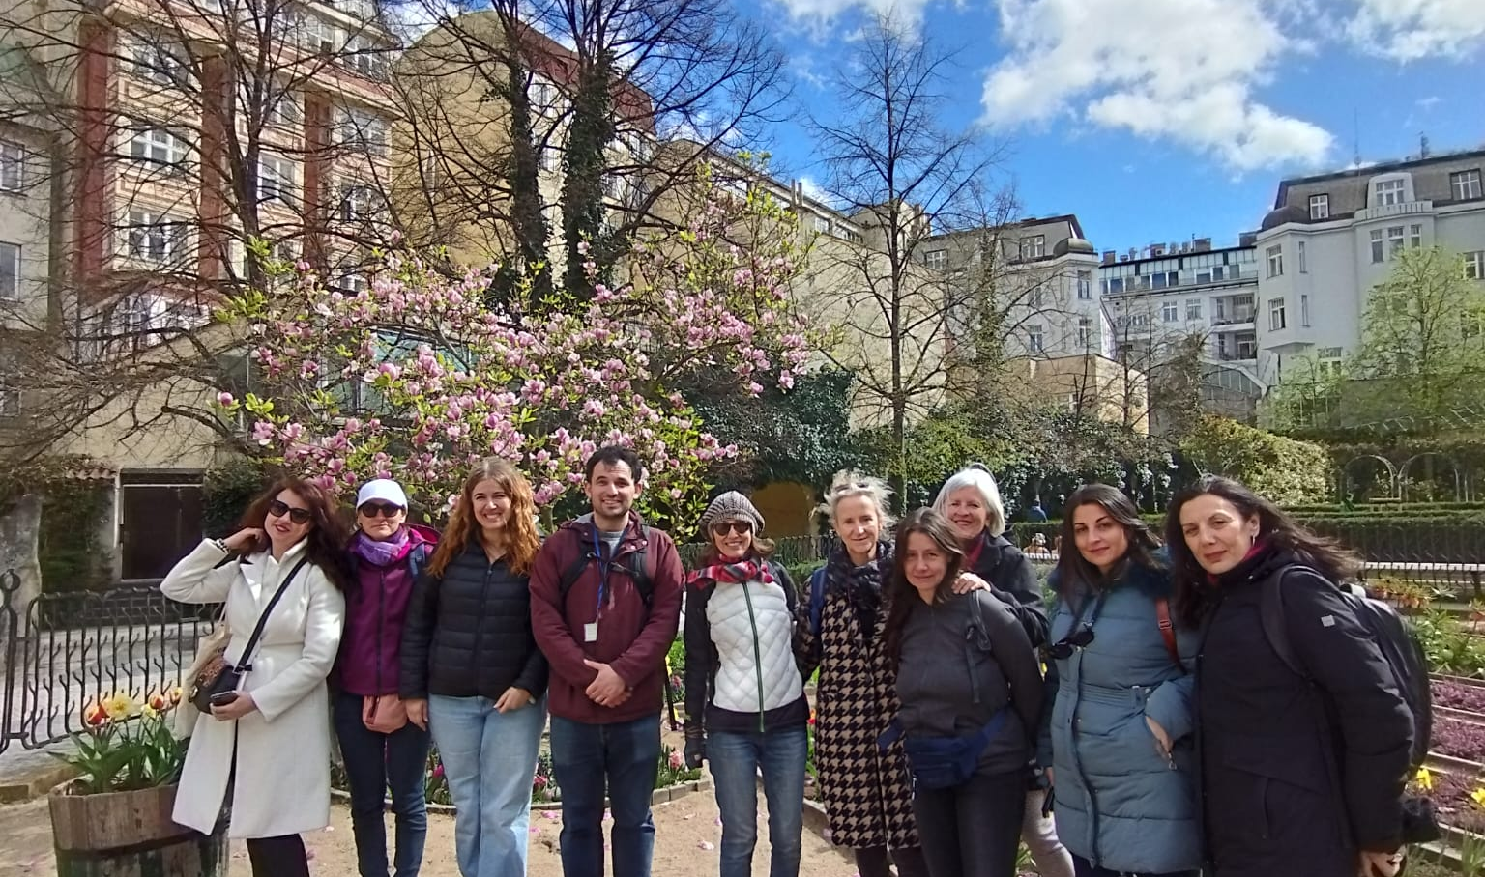
WHO WE WERE
The trainers
Presentation of our school IPSSEOA – Soverato - Italy
sightseeing
The course lasted 5 days and was completely in English. Our trainers came from the USA and from Russia.
We were 9 teachers coming from 4 different countries: Germany, Italy, Greece and Hungary.
Of course we a lovely guided tour in this splendid Czech city

Slide 5
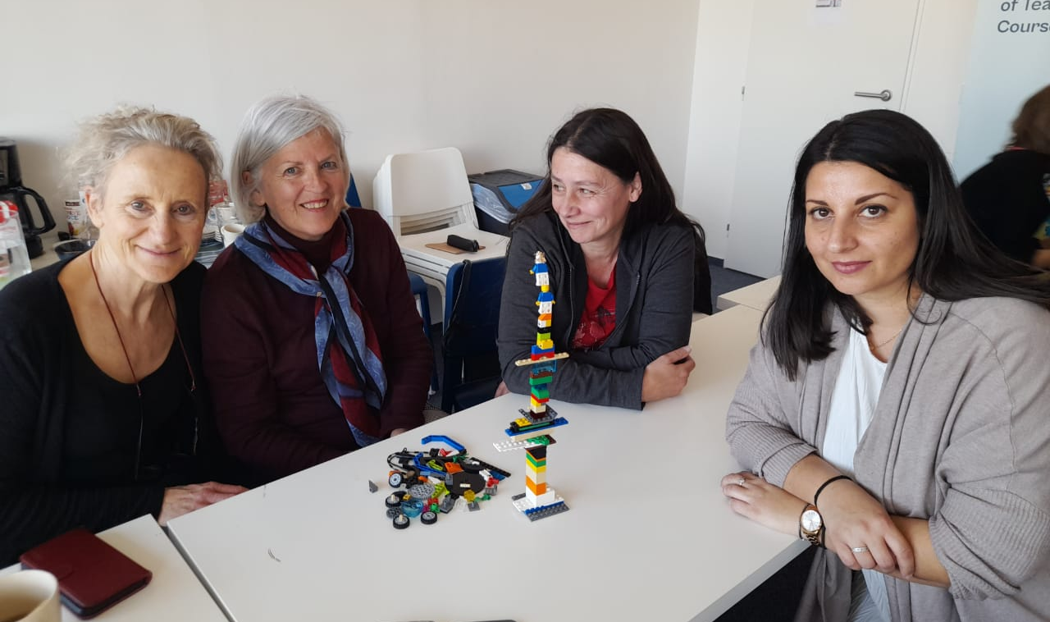
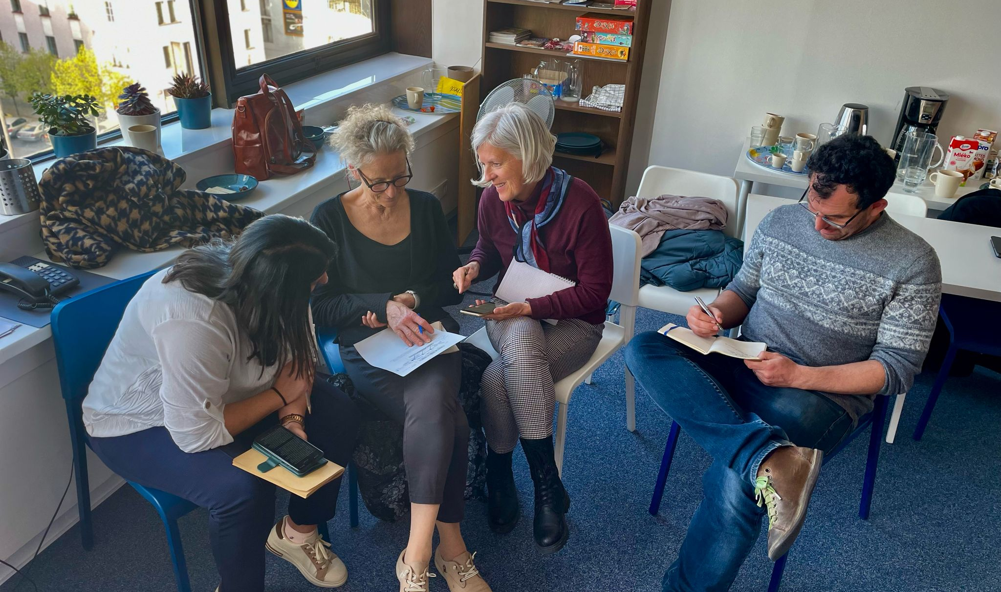
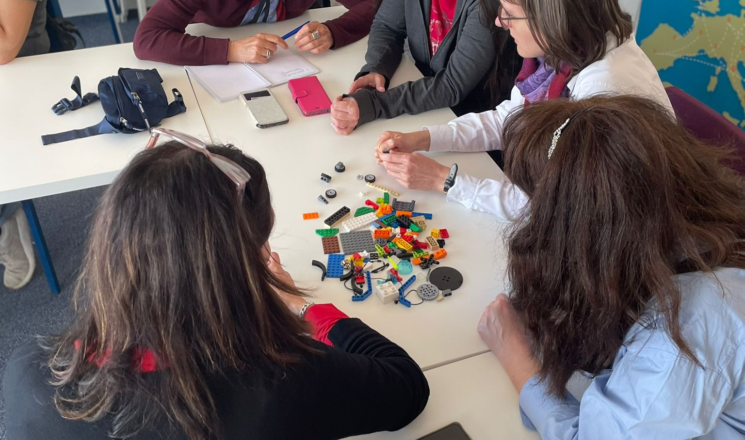
Classroom Activities
Team building
Group work
Challenges
There were various activities focusing on problem-solving, in a true learn-by-doing environment
We did a lot of group work concentrating on communication.
Every day there were new challenges, new methodologies and new discussions on how to teach and implement the 4 C’s.

Slide 6
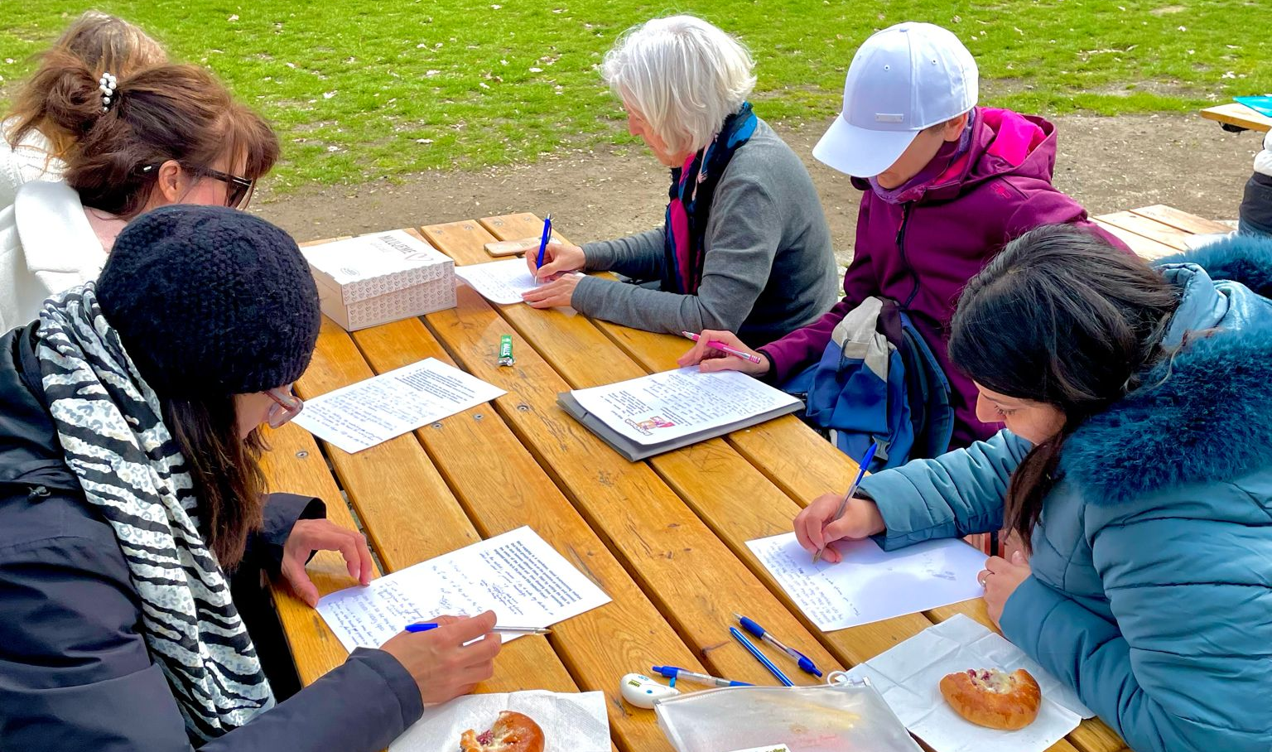
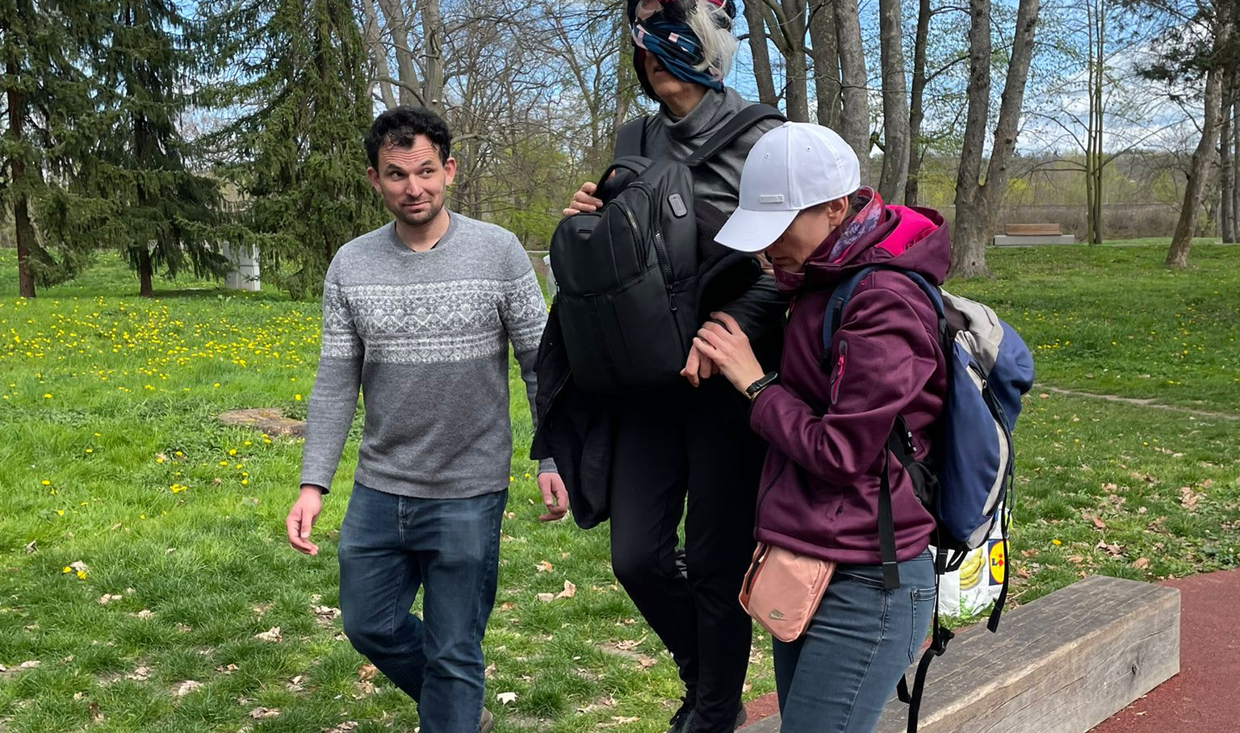
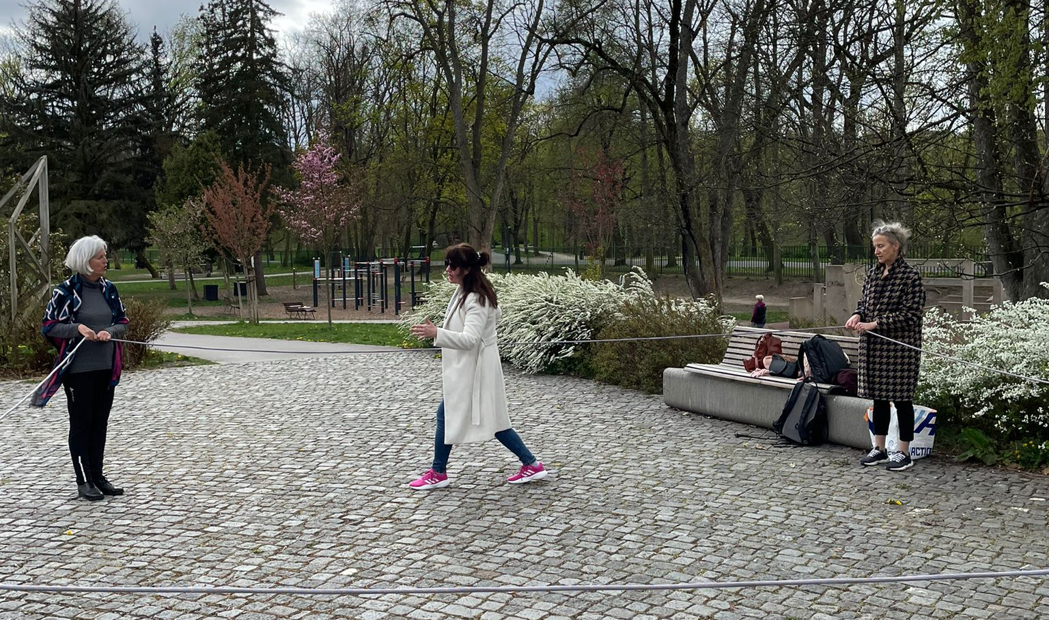
Outdoor activities
Communication
Trust building
Problem solving
Lesson and discussion regarding kinds of communication, verbal, written, non-verbal, digital, and artistic.; How to create and promote channels of communication and listening through collaborative work and social and emotional intelligence-building activities.
Learning different ways of trust building inside a class. Simulations of good communication, and group activities to generate new ideas about collaboration, creativity, and critical thinking
It was difficult to solve problems when you are dealing with different languages and professional backgrounds

Slide 7
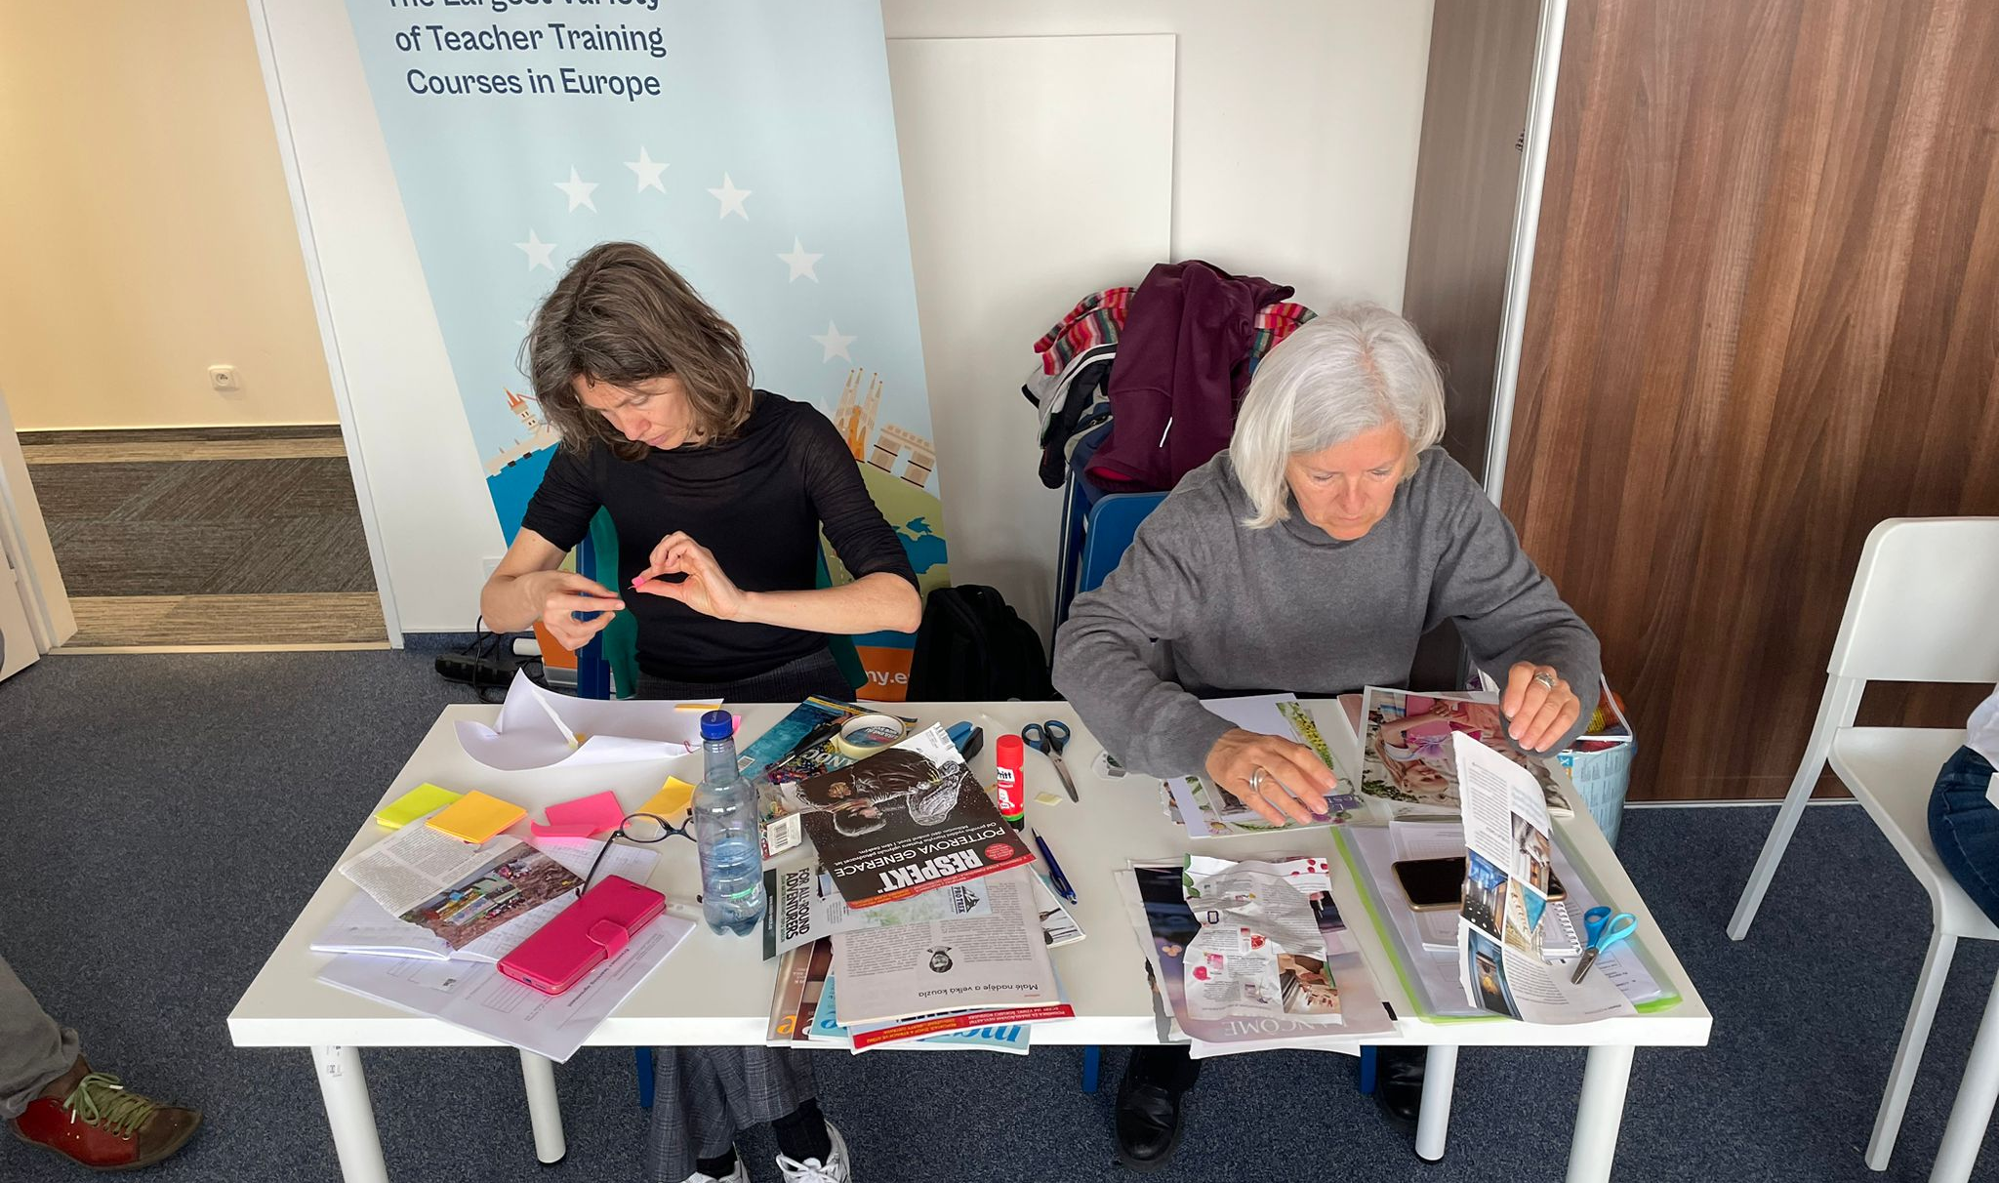
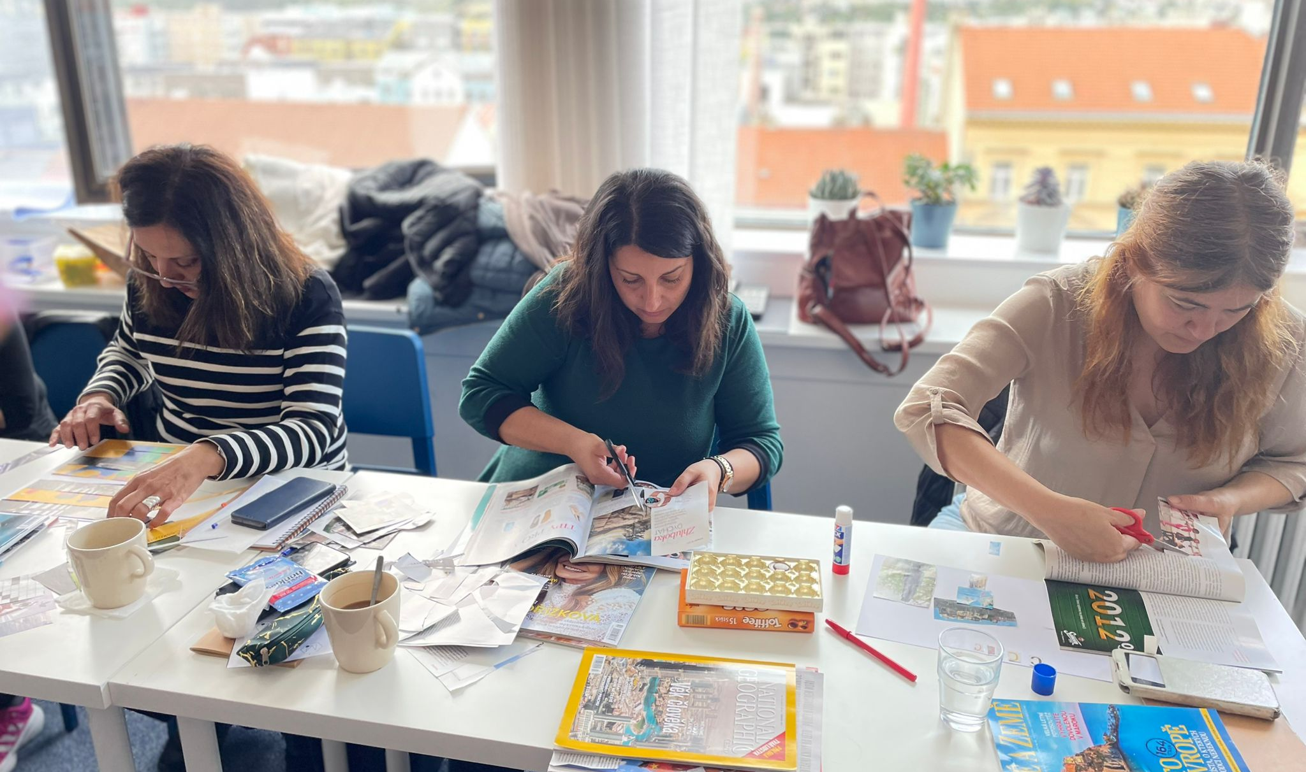
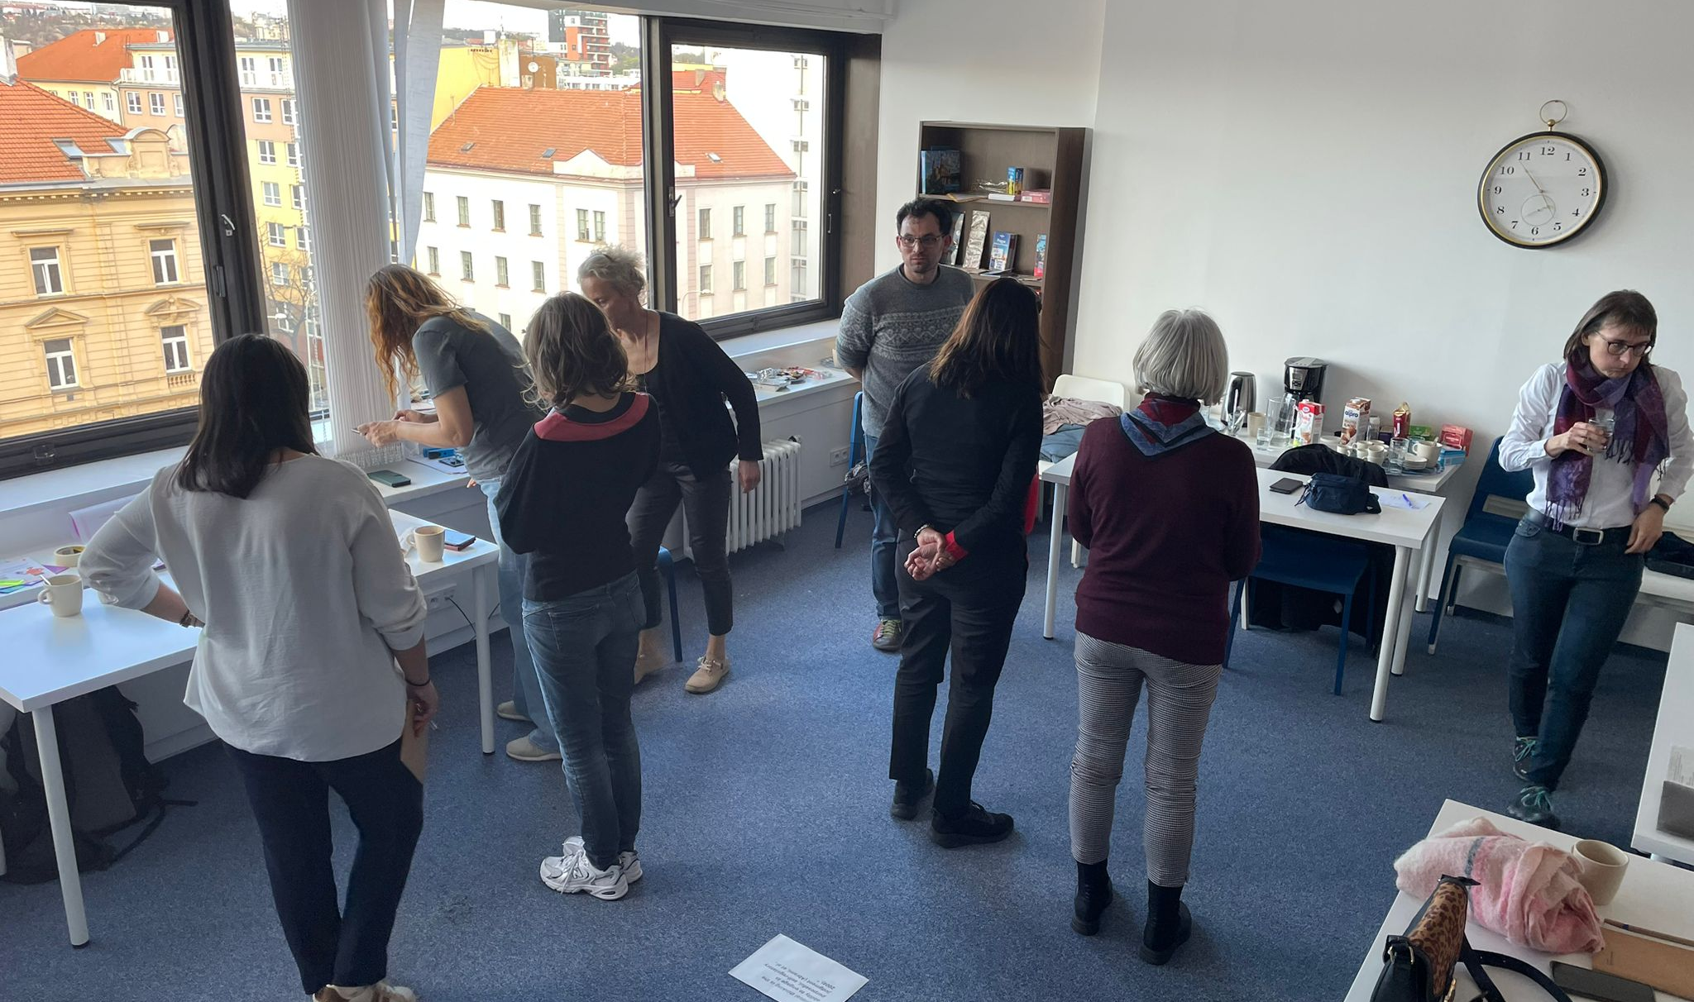
Learn how to teach creativity and critical thinking
Italian creativity
Greek Creativity
Critical thinking
Summarise what you have learnt through images, ;
Not forgetting the pitfalls to avoid when implementing the 4Cs.
The Greek participants were elementary school teachers that approached creativity in a completely different way.
Critical thinking is a fundamental second step of the creative process. This is perhaps the most difficult to propose to students. Reflections on different strategies.

Slide 8
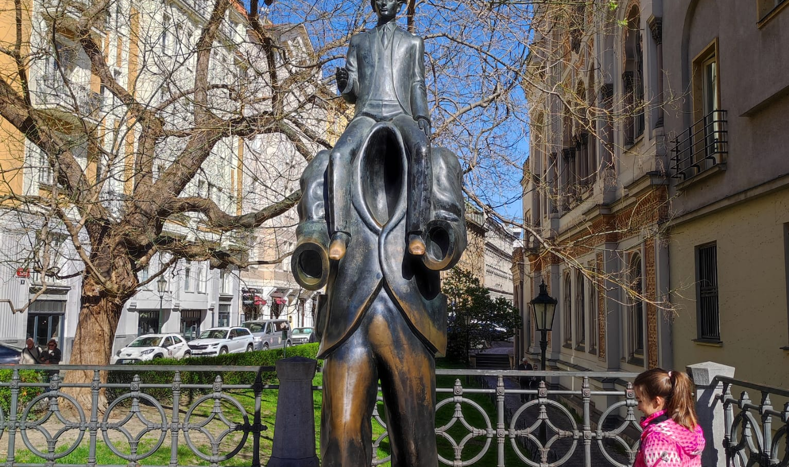
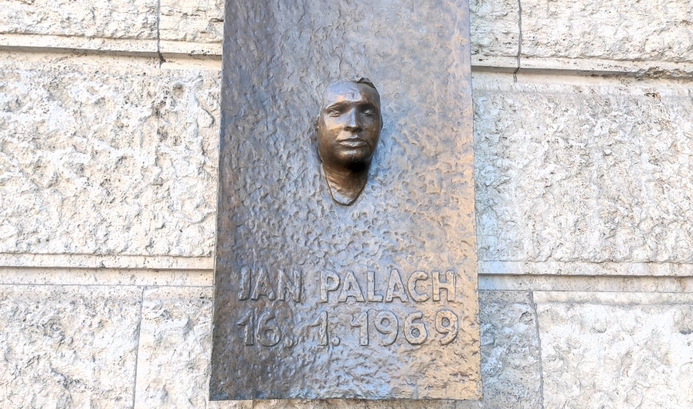
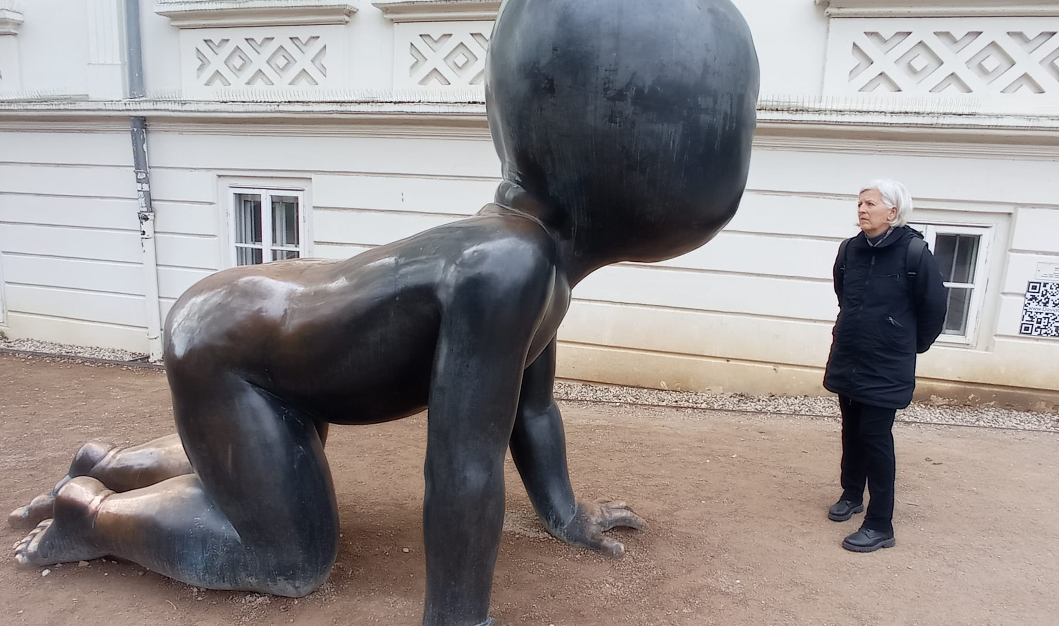
sightseeing
100 anni Kafka
Jan Pallach
Feeling very small
Franz Kafka (Prague, 1883 – Kierling, 1924) was a German-speaking Bohemian writer. is considered one of the major figures of 20th century literature and among the greatest exponents of modernism.
Jan Palach was a Czechoslovakian patriot who became a symbol of his country's anti-Soviet resistance.
Contemporary art

Slide 9
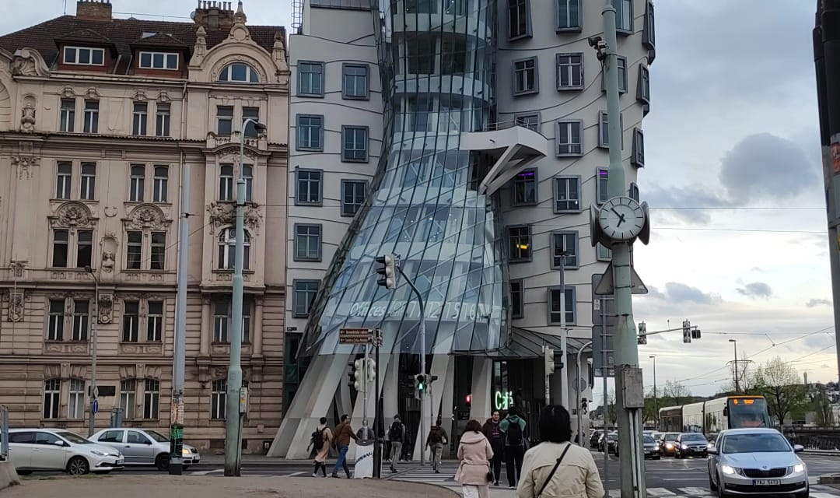
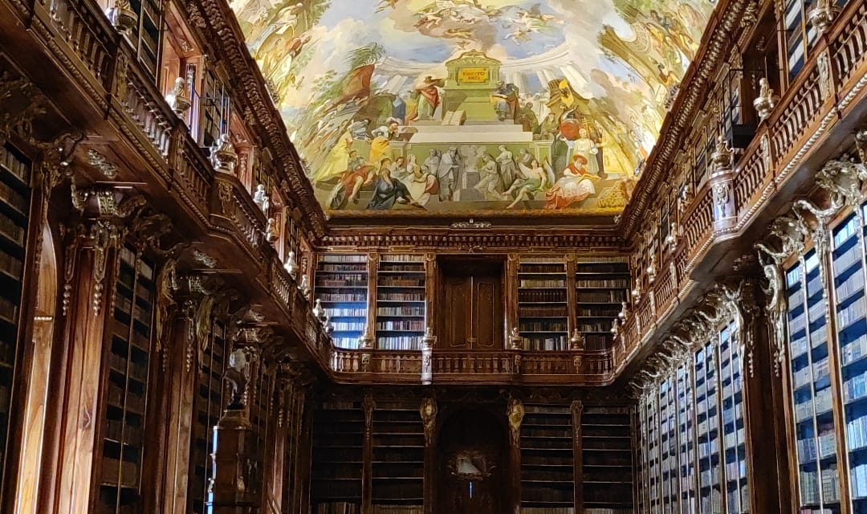
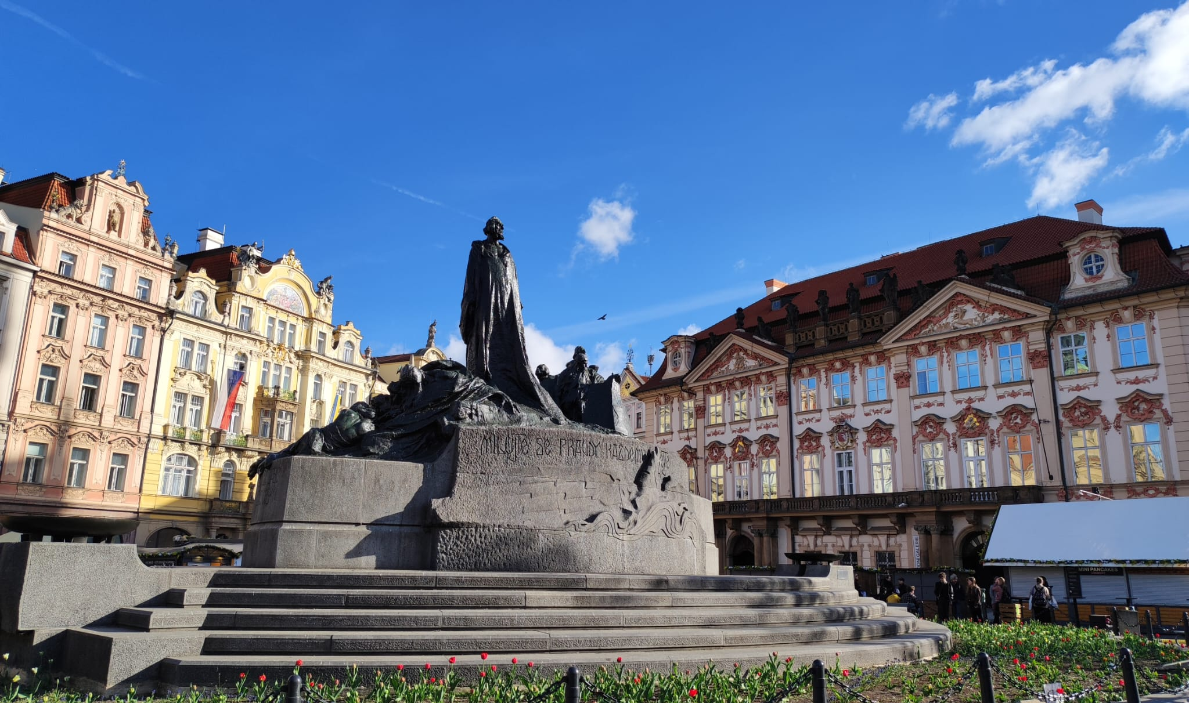
Prague in Spring
The dancing house
Clementinum library
Jan Hus
Built in 1996, it is considered one of the pillars of modern Prague architecture. The project was developed by architects Vlado Milunič to Frank O. Gehry. The design of the building is inspired by the dance style of the famous couple Fred Astaire (stone tower) and Ginger Rogers (glass tower).
Prague boasts one of the most beautiful baroque libraries in the world. The Library Hall, with its large, historically valuable globes and splendid frescoes by Giovanni Hiebel inspired by the theme of science and art, was completed in 1727.
In the 15th century Bohemia was agitated by the Hussite movement. The Czech Jan Hus denounces the state of corruption of the clergy. Excommunicated, Hus is tried and condemned to the stake. The Hussites gave rise to a vast opposition movement to the Catholic hierarchies and the Germans.

Slide 10
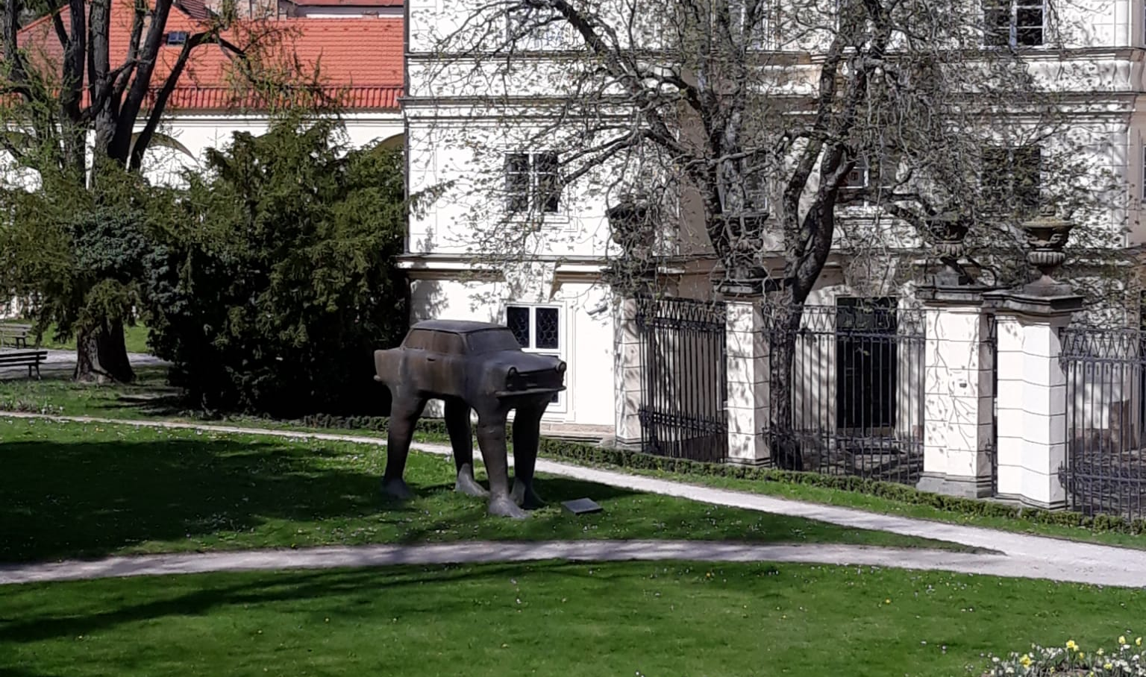
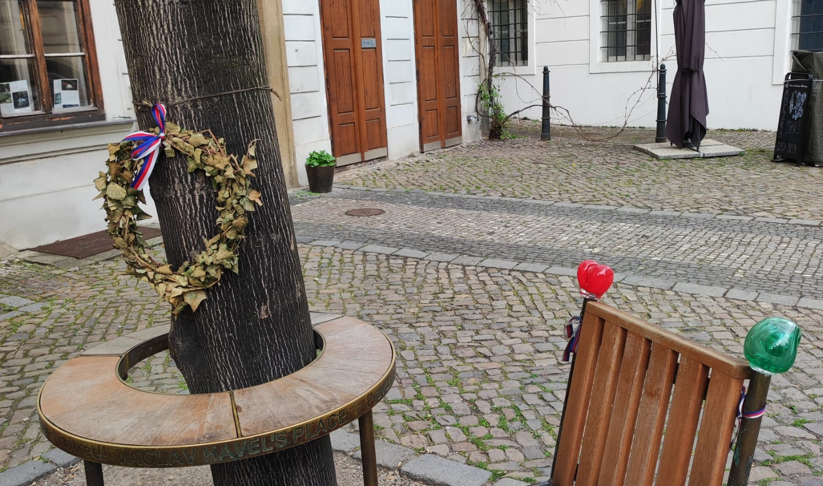
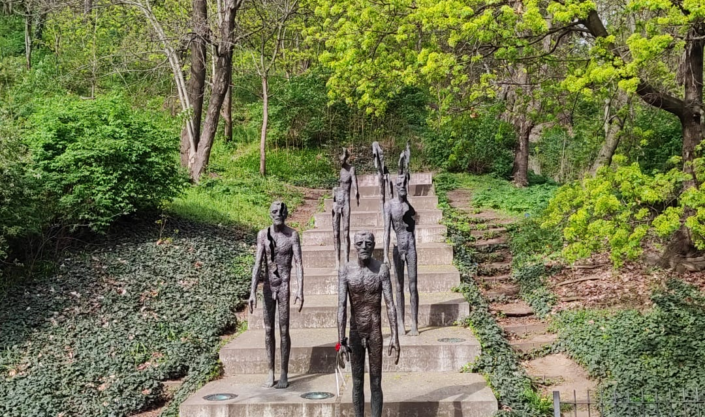
What else did we learn
The trabant car
Havel’s place
The Monument of the victims of Comunism
The Trabant is the car that was produced from the year 1957 until 1990 in the then East Germany
Havel’s Place is a memorial dedicated to Václav Havel. It comprises two chairs linked by a round table with a tree growing through its center.
The monument represents seven bronze statues descending a flight of stairs. The figures appear more worn the further away they are from the observer, losing limbs and with lacerations in their bodies, symbolizing the way in which political prisoners were affected by communism between 1948 and 1989 .

Slide 11
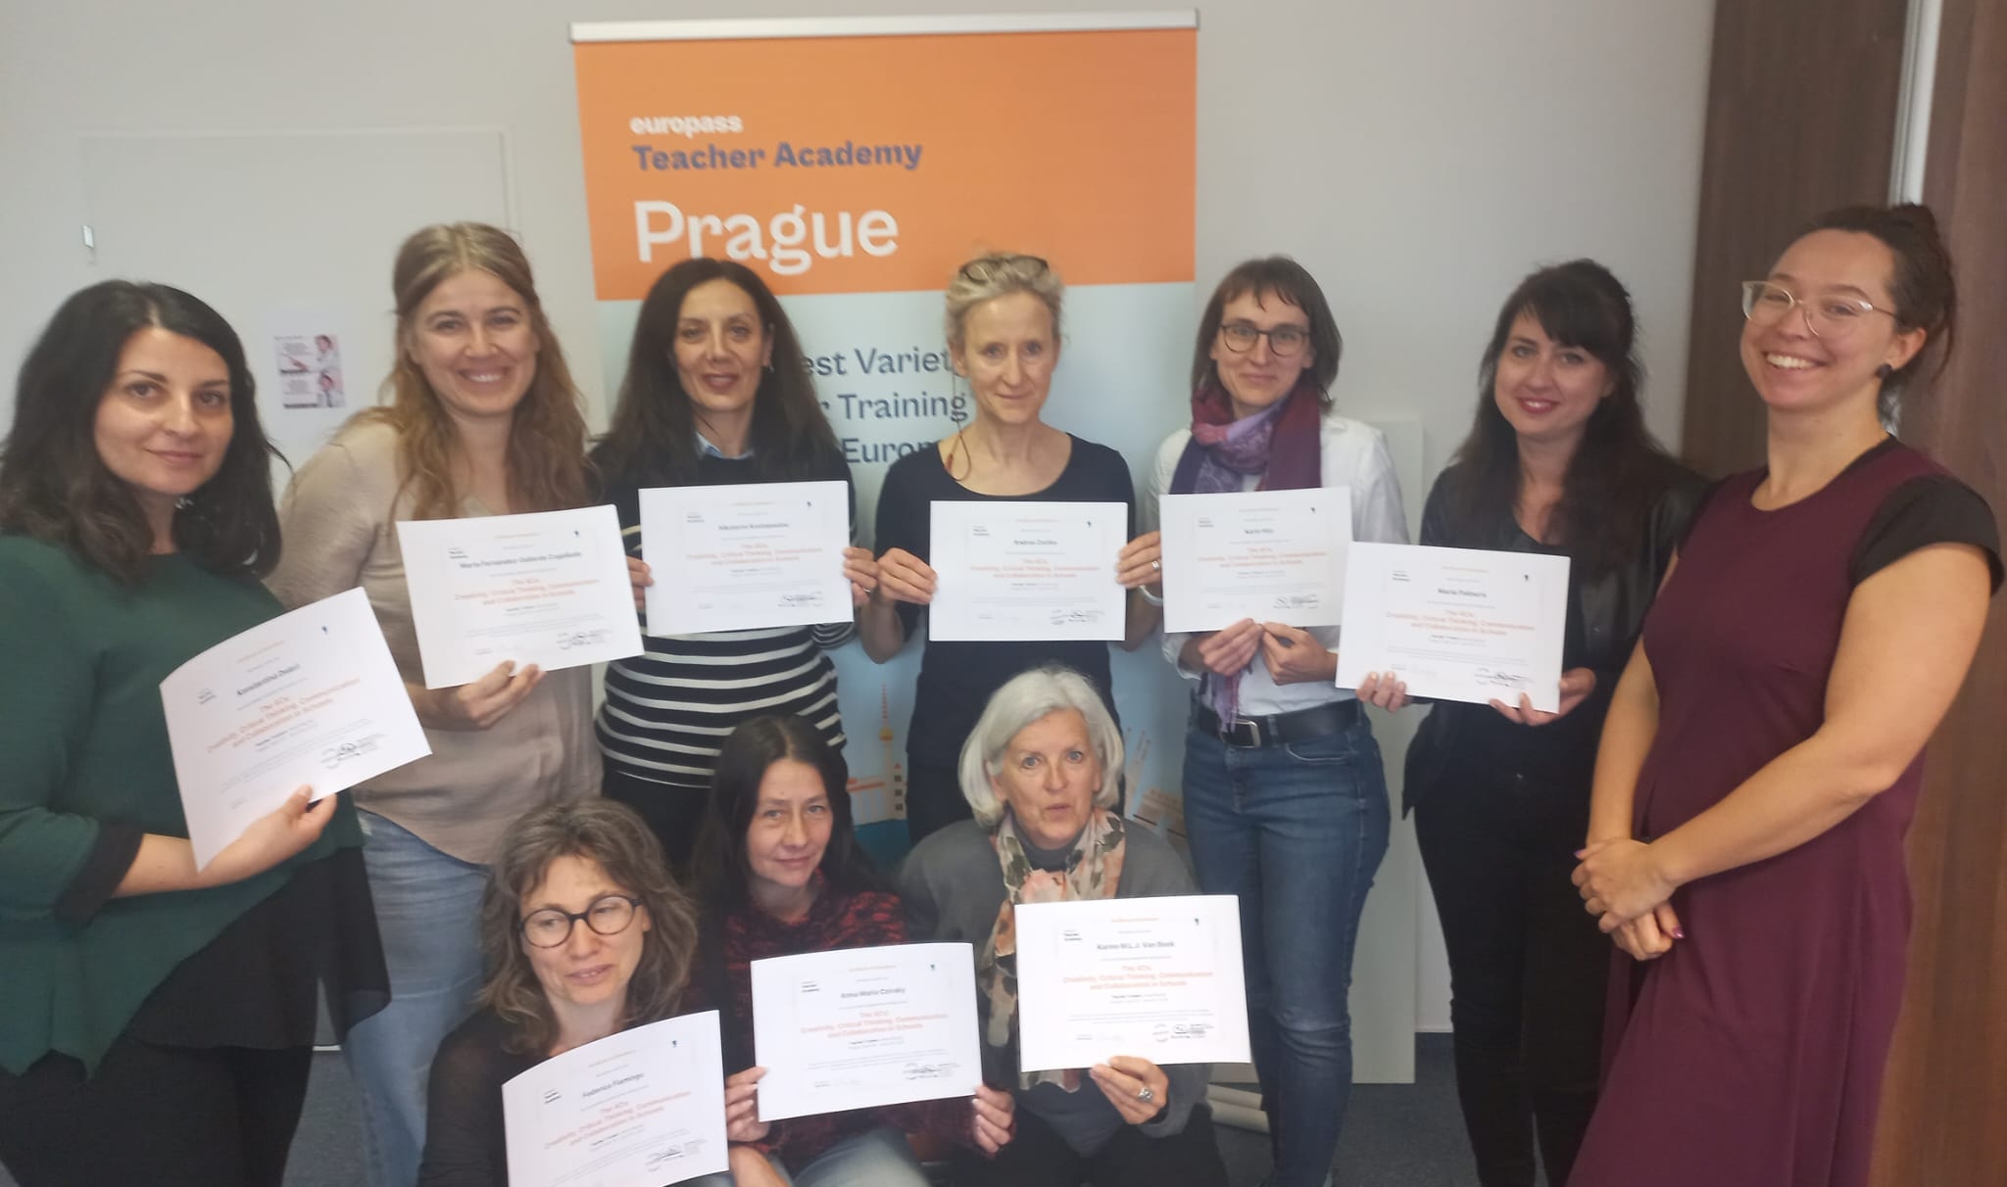
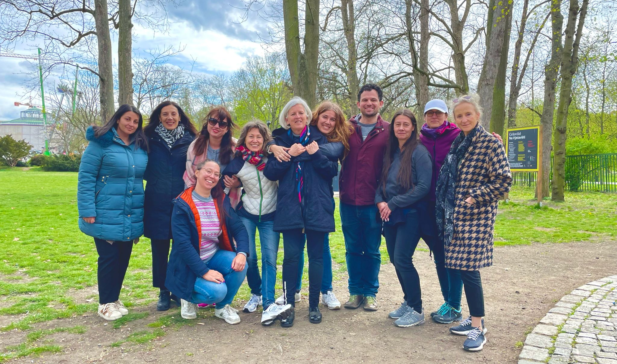
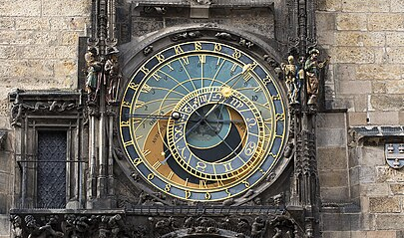
Esito finale
CERTIFICATE
THE GROUP
Astronomical clock
This course provided us with the knowledge, know-how, and confidence to incorporate these stimulating skills into their curriculum and school environment
These experiences give you the opportunity to do some networking, to compare good practices, similarities and differences in other countries of the EU
Tick tock the clock was ticking and after 5 demanding days we had to say good bye…I’d like to thank the EU for this wonderful experience.

Slide 12
outcome
We gained a clear understanding of the creative process and experience it first-hand;
We learnt strategies on how to think critically and get the most out of today's information overload;
We were offered more effective communication abilities and techniques;
Most of all we gained knowledge on how to broaden collaborative opportunities in the classroom and encourage them in all aspects of the school community;
The course was interesting because we lived a truly international team-building experience.

